Slide 1
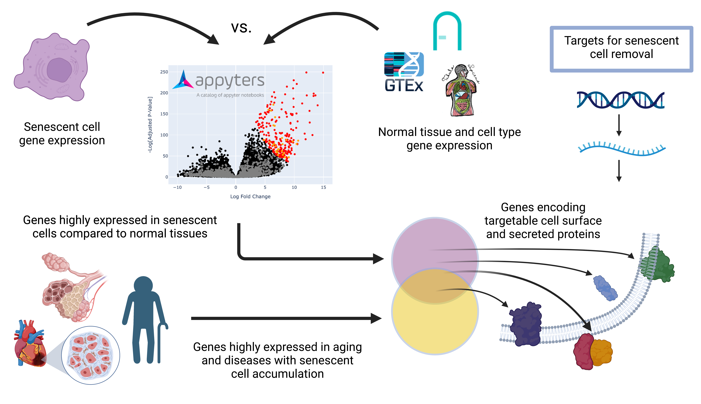
Notes:
Figure 1: computational workflow

Slide 2
Study Author(s) | GEO Accession | Study Title | Cell Types and Samples
Marthandan et al. (2015) | GSE64553 | Hormetic effect of rotenone in primary human fibroblasts | WI-38 fibroblasts (n = 3) IMR-90 fibroblasts (n = 3)
Marthandan et al. (2016) | GSE63577 | Conserved senescence associated genes and pathways in primary human fibroblasts detected by RNA-seq | MRC-5 fibroblasts (n = 3) WI-38 fibroblasts (n = 3) BJ fibroblasts (n = 3) IMR-90 fibroblasts (n = 3) HFF fibroblasts (n = 3)
Casella et al. (2019) | GSE130727 | Transcriptome signature of cellular senescence | WI-38 fibroblasts (n = 2) IMR-90 fibroblasts (n = 2)
DeCecco et al. (2019) | GSE109700 | L1 drives IFN in senescent cells and promotes age-associated inflammation | LF1 fibroblasts - early senescence (n = 3) LF1 fibroblasts - deep senescence (n = 3)
Sen et al. (2019) | GSE105951 | Histone acetyltransferase p300 induces de novo super-enhancers to drive cellular senescence | IMR-90 fibroblasts (n = 4)
Voic et al. (2019) | NA | RNA sequencing identifies common pathways between cigarette smoke exposure and replicative senescence in human airway epithelia | Bronchial epithelial cells (n = 5)
Notes:
Table 1: Senescence studies and RNA-seq samples

Slide 3
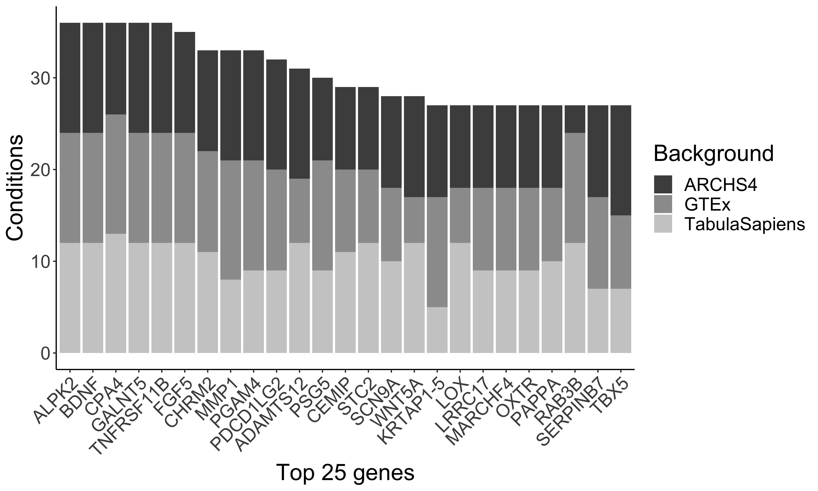
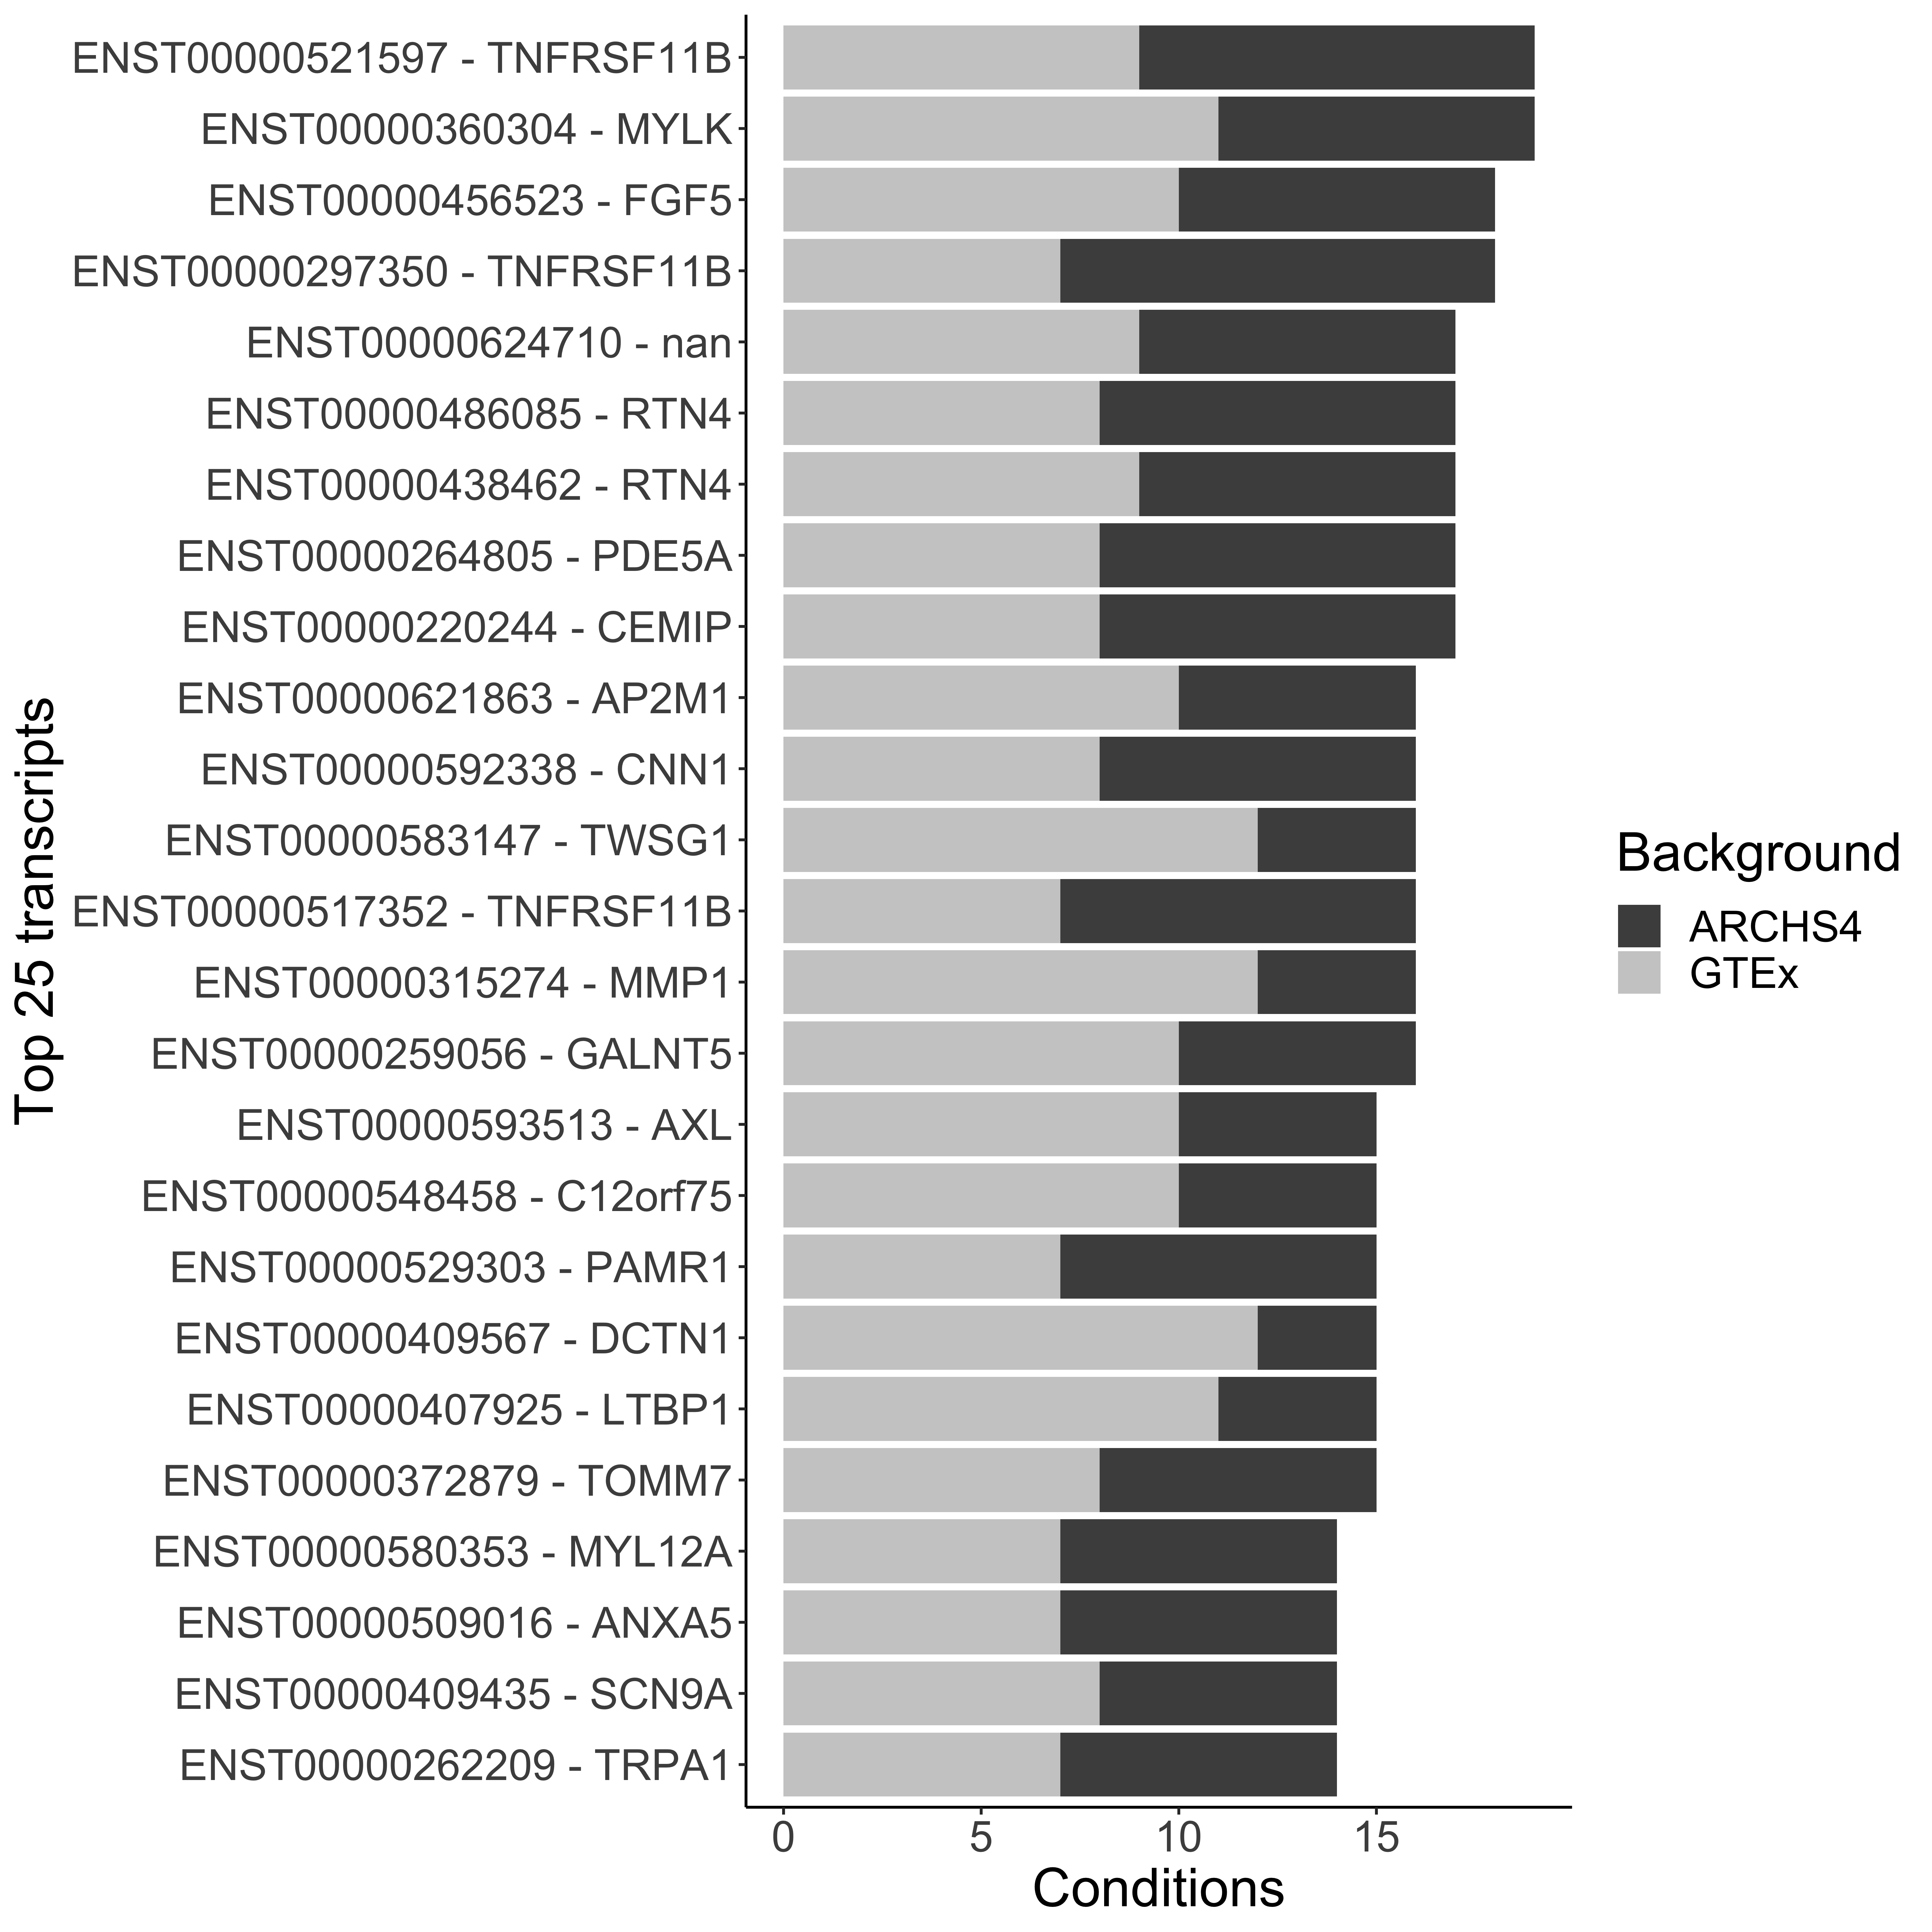
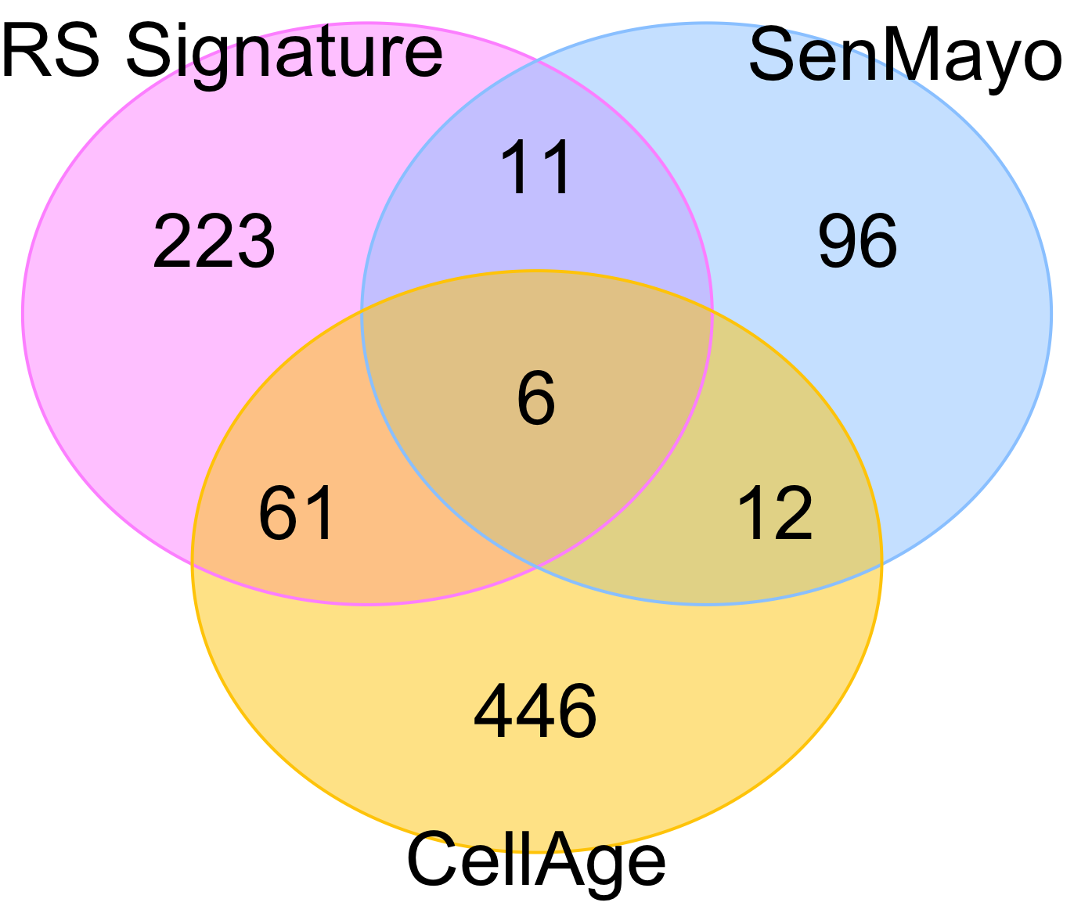
Notes:
Figure 2A-2C: Top genes and transcripts differentially expressed in RS samples.

Slide 4
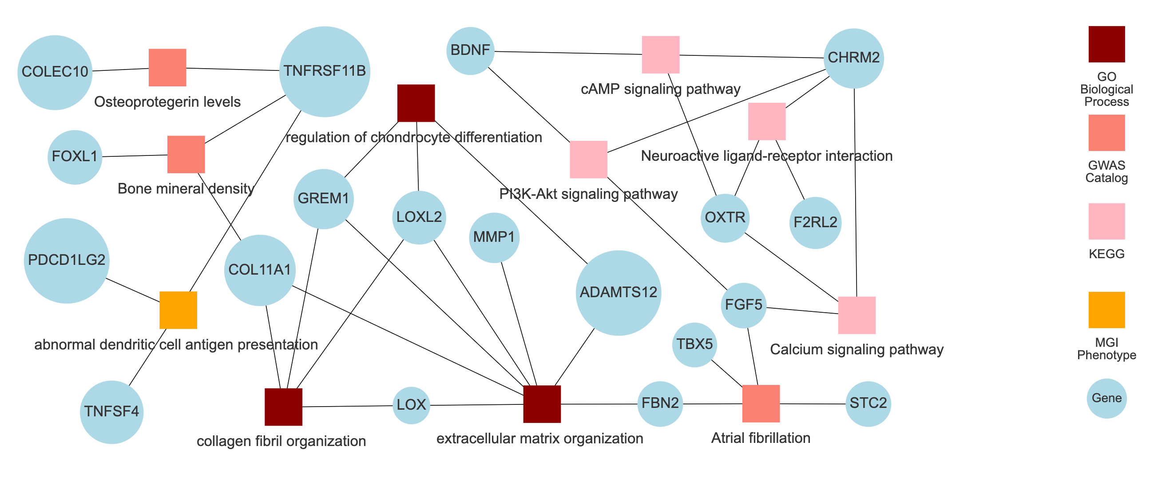
Notes:
Enrichment terms in top 34 RS genes

Slide 5
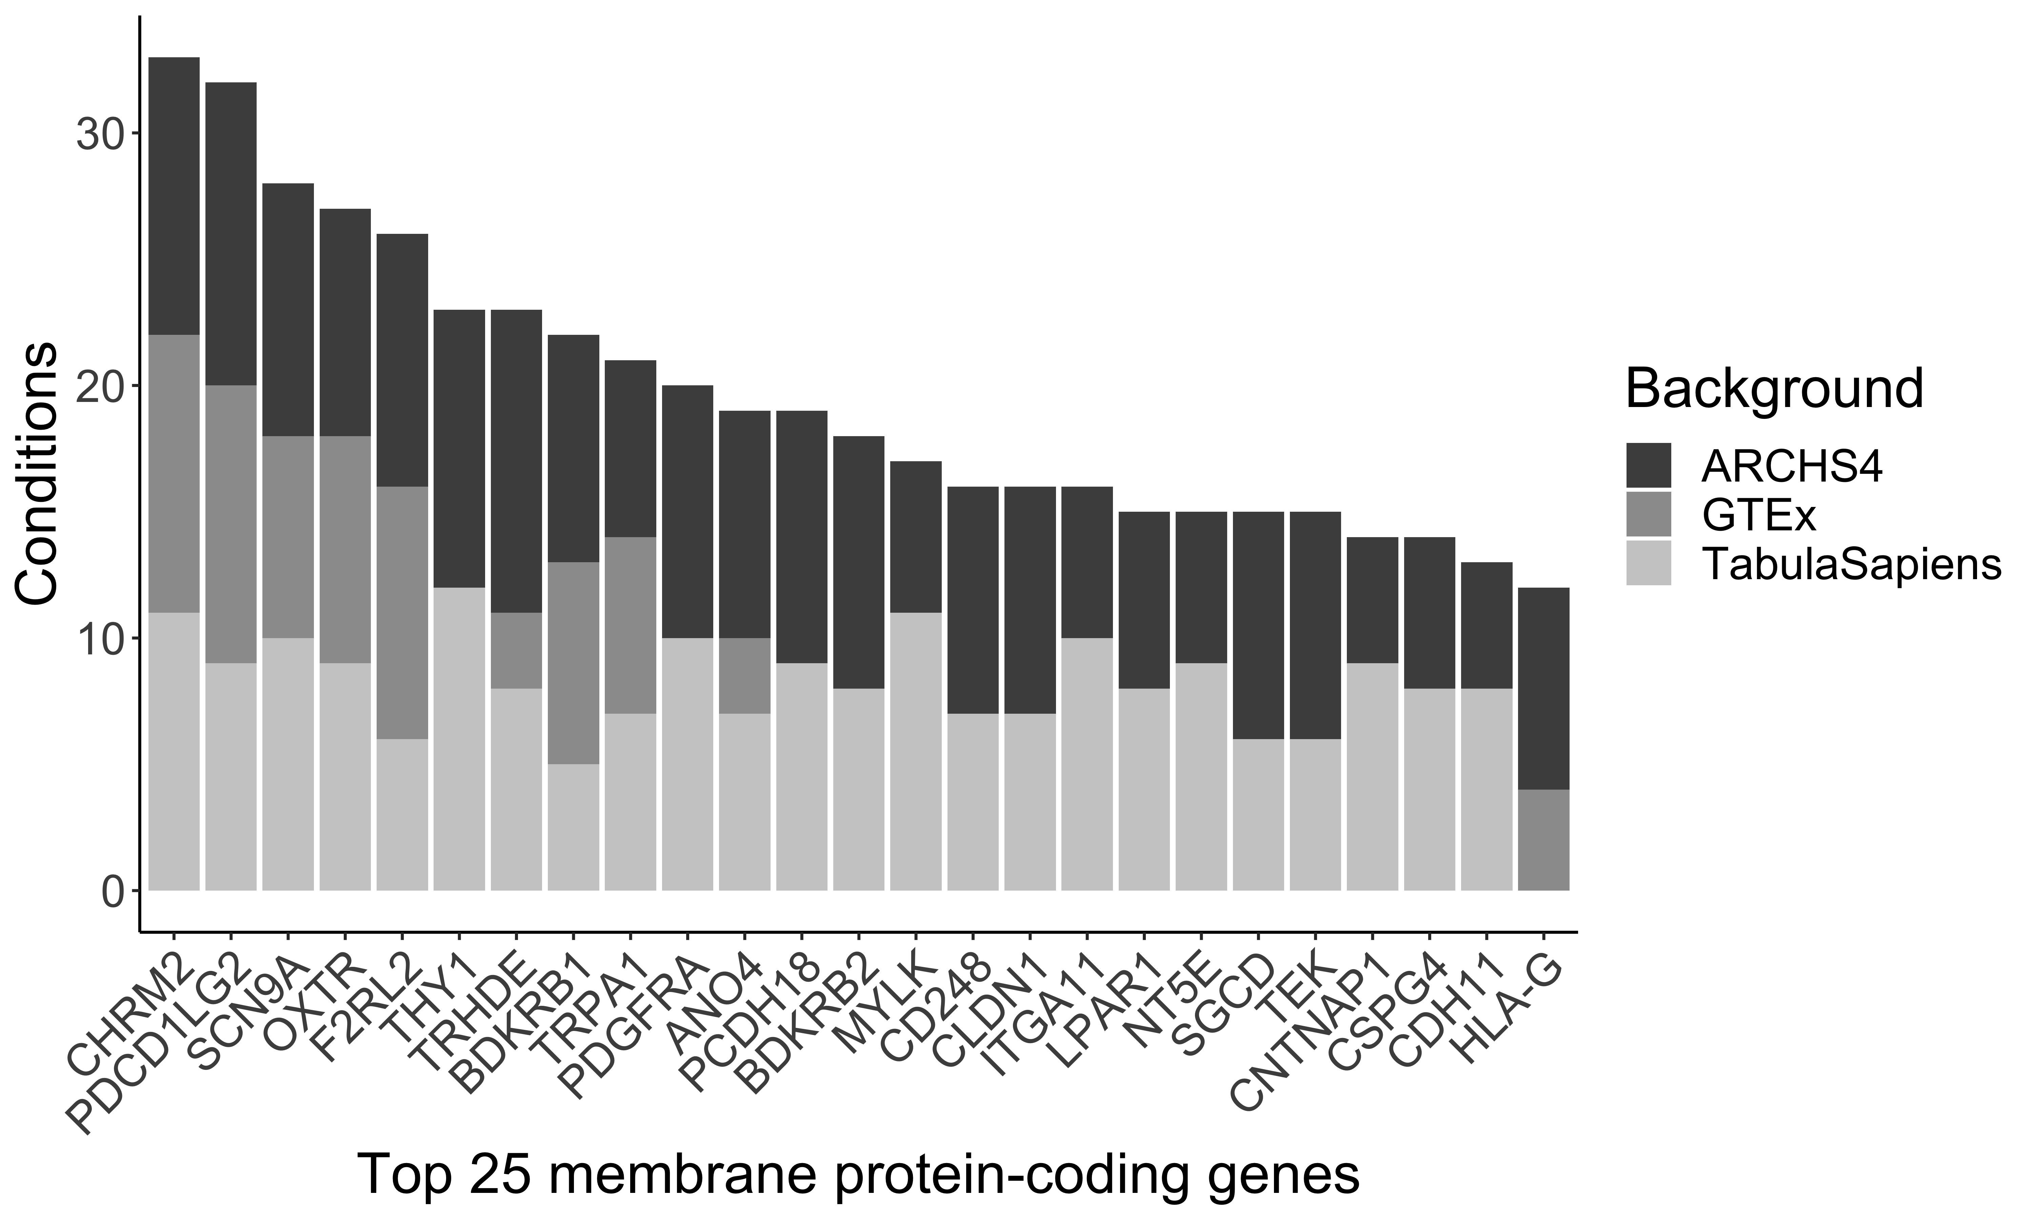
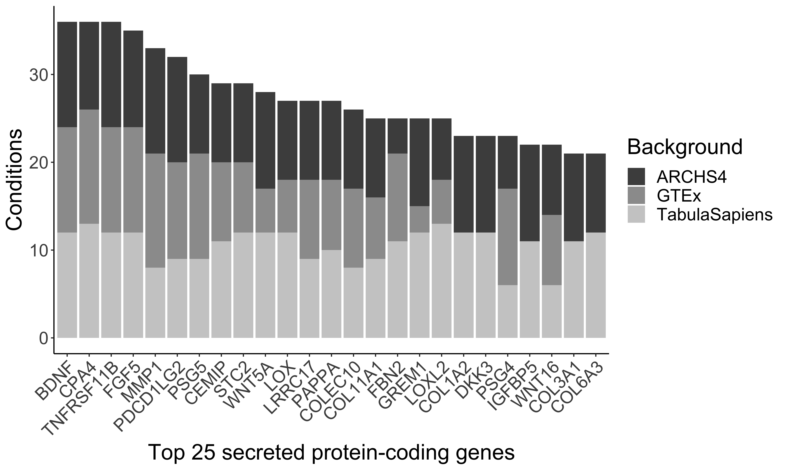
Notes:
Figure 3A: Gene-level targets

Slide 6
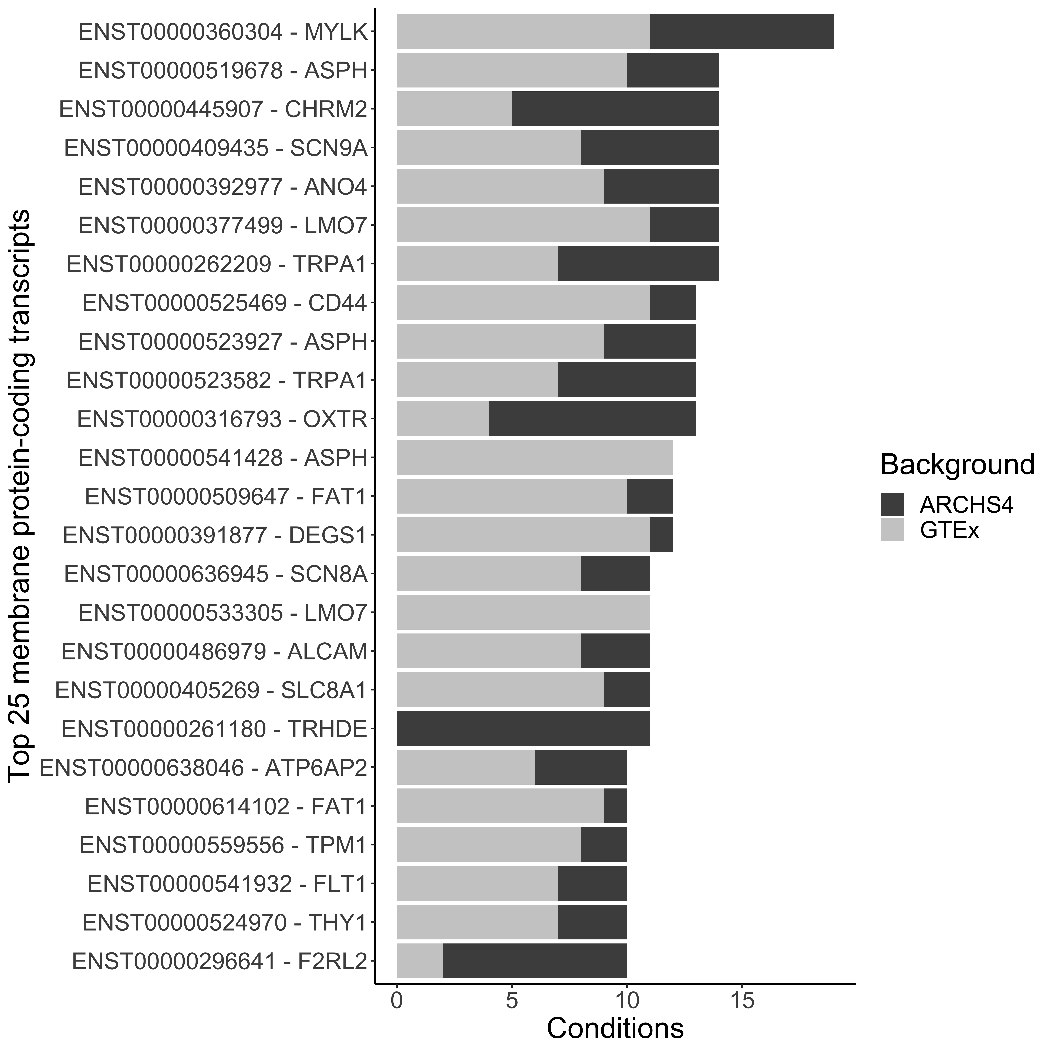
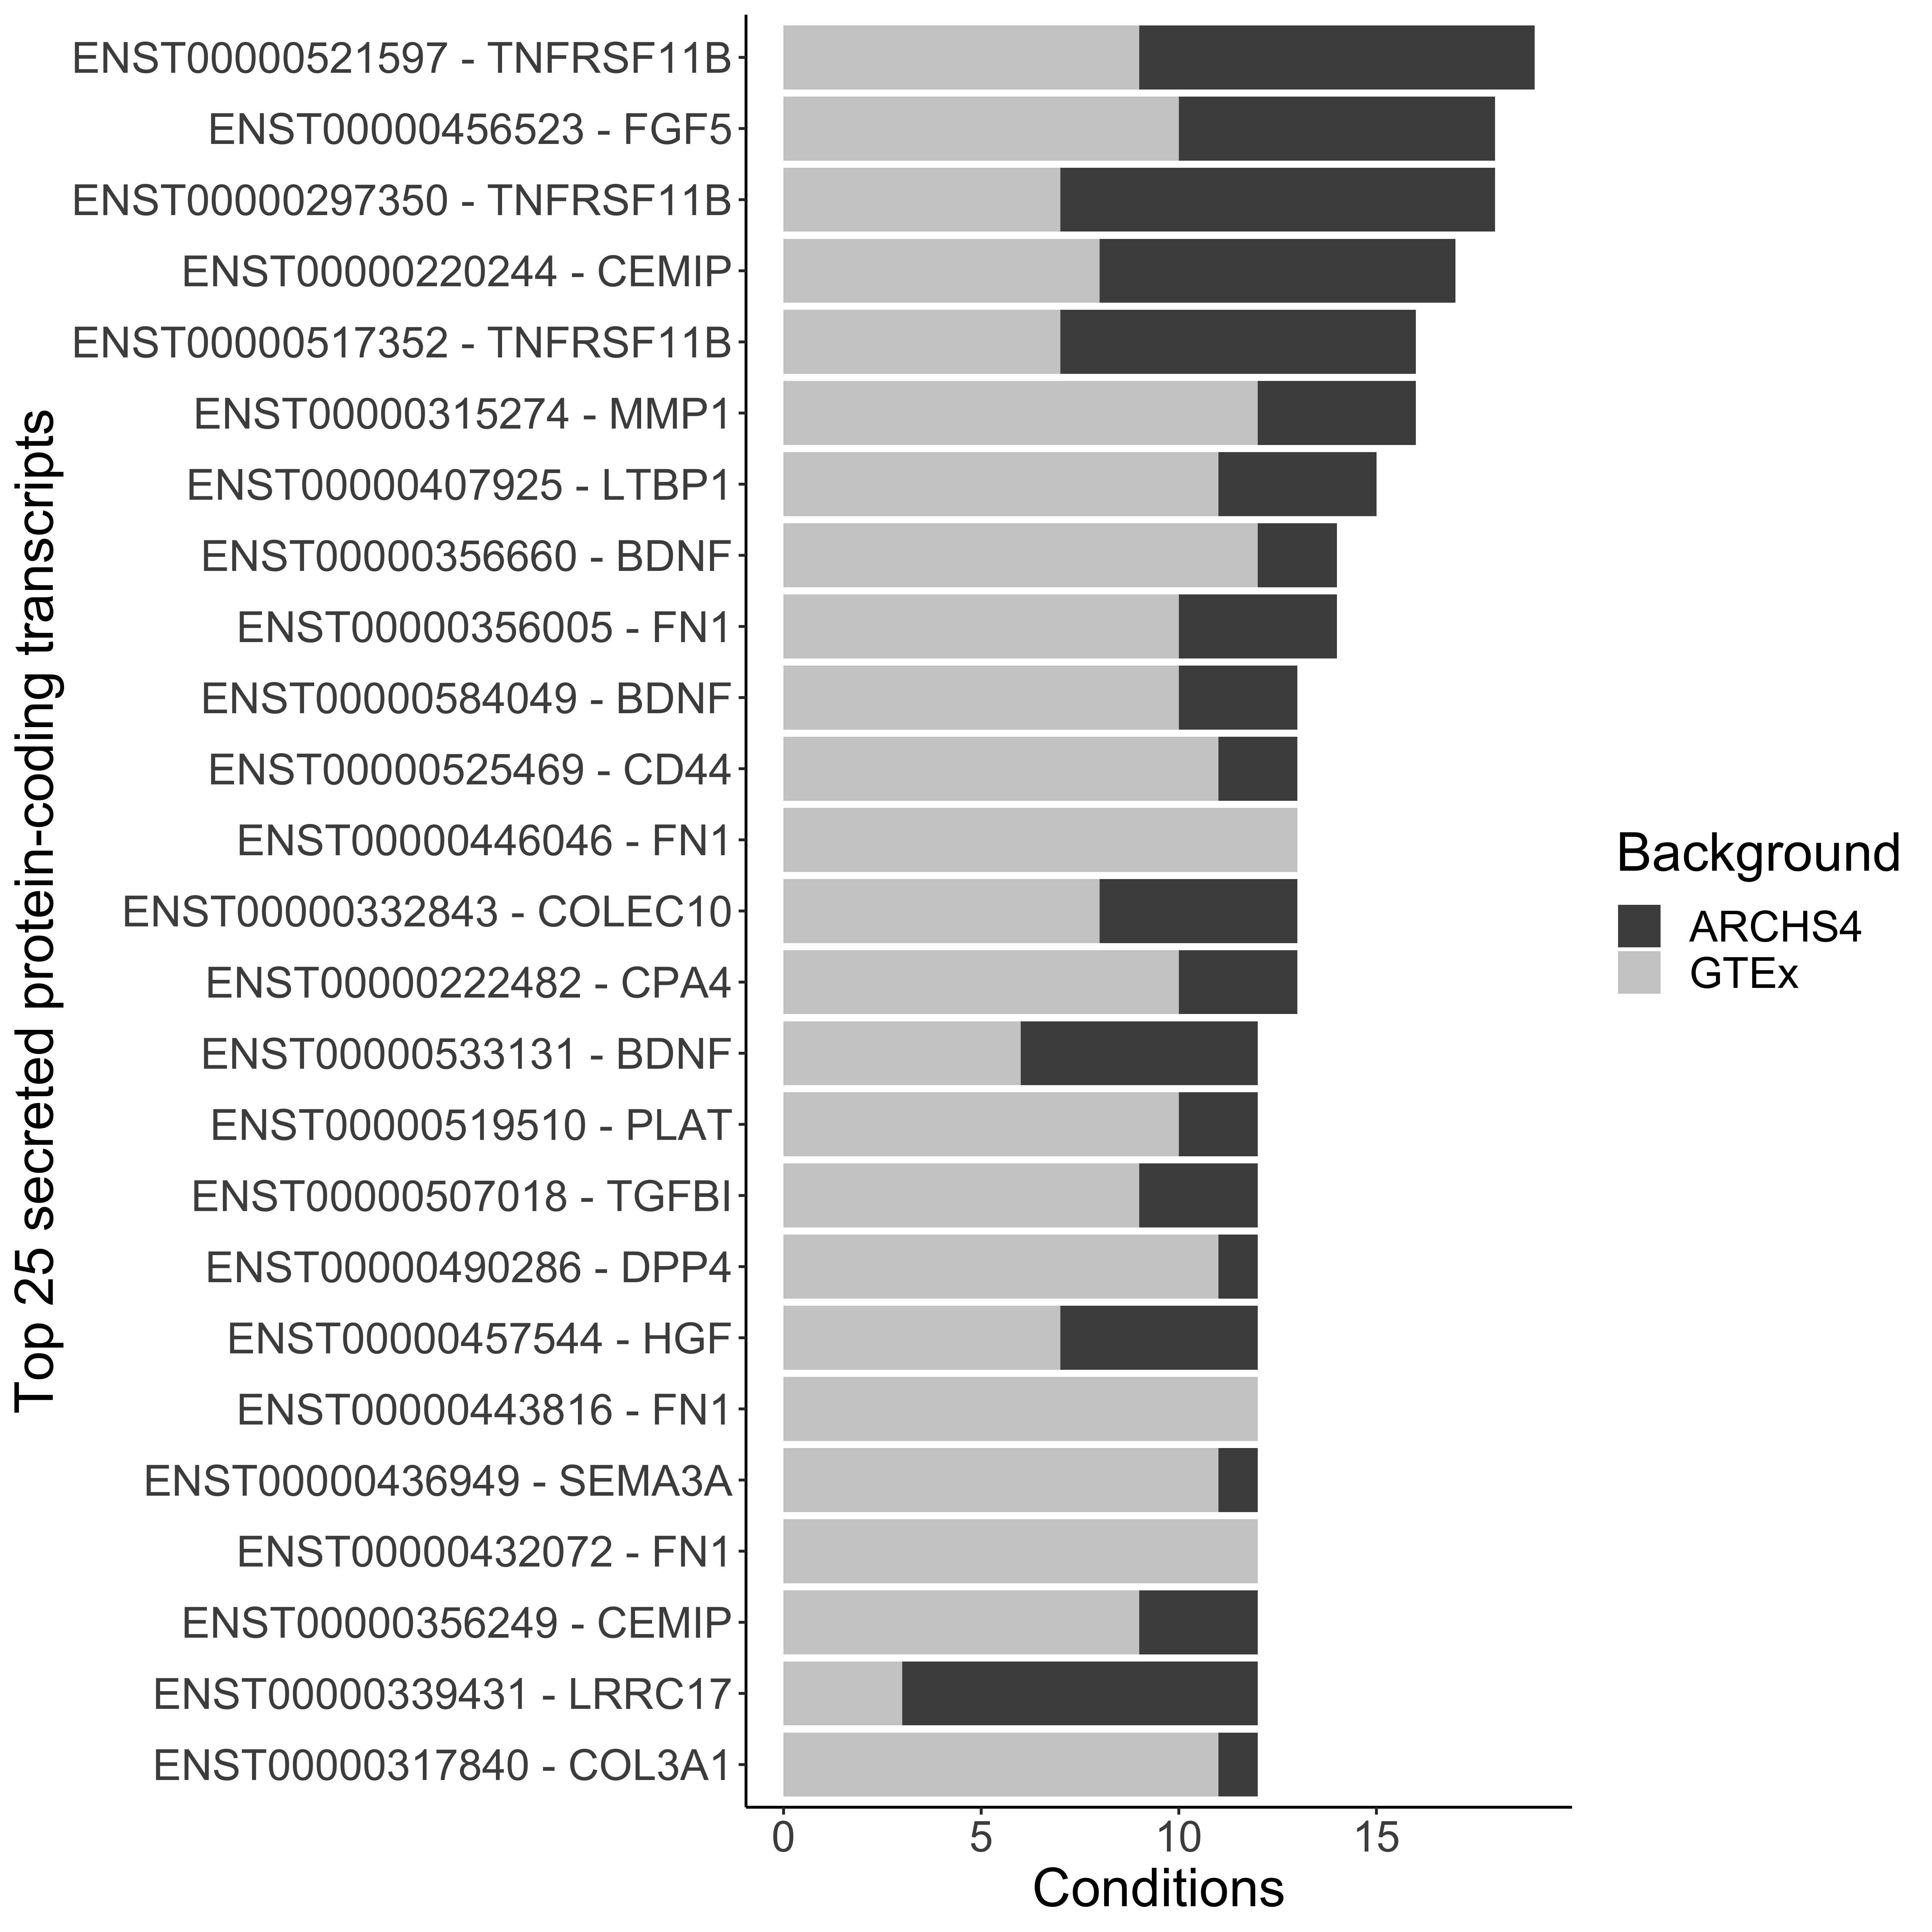
Notes:
Figure 3B: Transcript-level targets

Slide 7
Gene | Gene Description | Significant Transcript(s) | Aged Tissue | Disease Tissue | Senescence Status in Literature
CHRM2 | Cholinergic receptor muscarinic 2 | ENST00000401861; ENST00000445907 | None | None | Unknown
PDCD1LG2 | Programmed cell death 1 ligand 2 | ENST00000397747 | Blood Vessel | None | CellAge senescence gene
SCN9A | Sodium voltage-gated channel alpha subunit 9 | ENST00000303354; ENST00000409435; ENST00000409672; ENST00000454569 | None | None | Promotes senescence via Rb pathway
OXTR | Oxytocin receptor | ENST00000316793; ENST00000431493 | Blood vessel; brain | None | Hypermethylated in anti-senescent response in human dermal fibroblasts
F2RL2 | Coagulation factor II thrombin receptor like 2 | ENST00000296641 | Blood vessel; lung; nerve | Idiopathic pulmonary fibrosis | Unknown
THY1 | Thy-1 cell surface antigen | ENST00000524970 | Blood vessel | Idiopathic pulmonary fibrosis; heart failure | Associated with fibrotic response in IPF
TRHDE | Thyrotropin releasing hormone degrading enzyme | ENST00000261180; ENST00000547300; ENST00000549138; ENST00000549922 | Lung | None | Unknown
BDKRB1 | Bradykinin receptor B1 | None | None | None | Unknown
TRPA1 | Transient receptor potential cation channel subfamily A member 1 | ENST00000262209; ENST00000520596; ENST00000522271; ENST00000523582 | None | None | Protective role in cardiac fibrosis
PDGFRA | Platelet derived growth factor receptor alpha | ENST00000509490 | None | None | Receptor for senescence-associated factor for wound healing
Notes:
Table 2: Top 10 membrane-bound target genes

Slide 8
Gene | Gene Description | Significant Transcript(s) | Aged Tissue | Disease Tissue | Senescence Status in Literature
BDNF | Brain derived neurotrophic factor | ENST00000356660; ENST00000530786; ENST00000533131; ENST00000584049 | None | None | Secreted by senescent fibroblasts to promote plasticity in keratinocytes; promotes cardiomyocyte contractility
CPA4 | Carboxypeptidase A4 | ENST00000222482; ENST00000493259 | None | None | CellAge senescence gene; promotes cardiomyocyte hypertrophy
TNFRSF11B | TNF receptor superfamily member 11b | ENST00000297350; ENST00000517352; ENST00000521597 | Blood vessel; brain | None | Known SASP protein; upregulated in vascular aging; SenMayo gene set
FGF5 | Fibroblast growth factor 5 | ENST00000312465; ENST00000456523; ENST00000503413 | Nerve | None | Member of a family of cytokines involved in fibroblast proliferation and aging
MMP1 | Matrix metallopeptidase 1 | ENST00000315274 | None | Idiopathic pulmonary fibrosis | SenMayo gene; known inducer of senescence in pulmonary fibroblasts
PDCD1LG2 | Programmed cell death 1 ligand 2 | ENST00000397747 | Blood vessel | None | CellAge senescence gene
PSG5 | Pregnancy specific beta-1-glycoprotein 5 | ENST00000342951; ENST00000366175 | None | None | CellAge senescence gene; upregulated in senescent hMSCs
CEMIP | Cell migration inducing hyaluronidase 1 | ENST00000220244; ENST00000356249; ENST00000394685; ENST00000495041 | Adipose; blood vessel | None | Upregulated in rheumatoid and osteoarthritis fibroblasts; induces fibrosis in osteoarthritic chondrocytes
STC2 | Stanniocalcin 2 | ENST00000519511 | None | None | CellAge senescence gene
WNT5A | Wnt family member 5A | ENST00000474267; ENST00000493406 | None | None | CellAge senescence gene; promotes senescence in multiple cell types
Notes:
Table 3: Top 10 extracellular ligand target genes

